Slide 1
Stochastic Planning with Lifted Symbolic Trajectory Optimization 基于提升符号轨迹优化的随机规划
Reporter: Hu GuoDong
2019/5/20

Slide 2
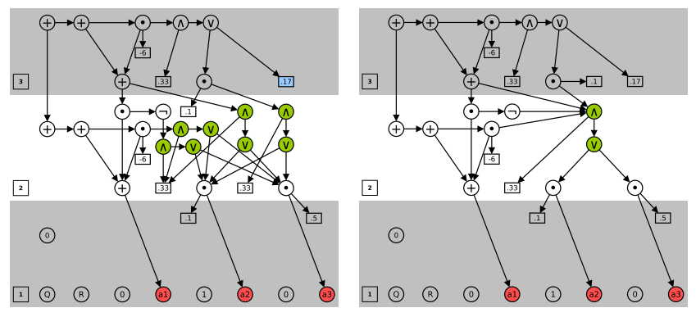
Main idea

Slide 3
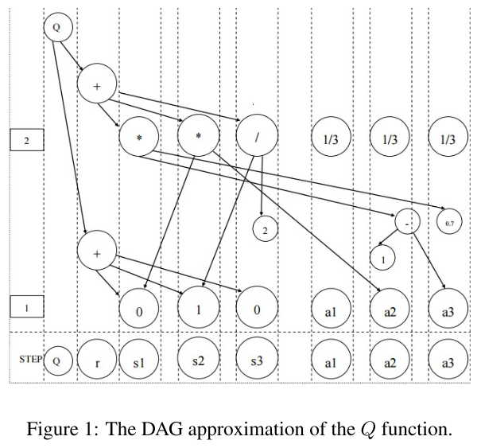
Basic SOGBOFA Algorithm

Slide 4
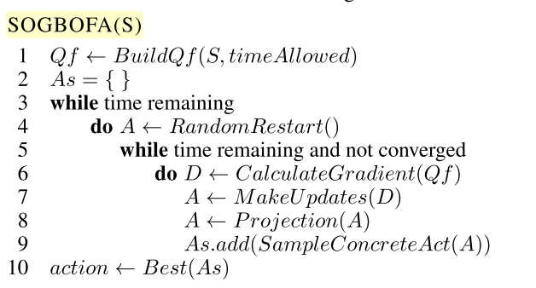
Basic SOGBOFA Algorithm

Slide 5
Basic SOGBOFA Algorithm
1. propagate values from leaves to root to compute Qπ(s, a)
2. compute gradients for all nodes
3. take a gradient ascent step for a1, . . . , an
4. pick the action with best Q value

Slide 6
Basic SOGBOFA Algorithm
Gradient based search: automatic differentiation
Maintaining action constraints: projected gradient ascent algorithm (Shalev-Shwartz 2012),
Transforming aggregate actions to concrete actions
Action Evaluation Step
Dynamic simulation depth （kalobov, keller UCT）

Slide 7
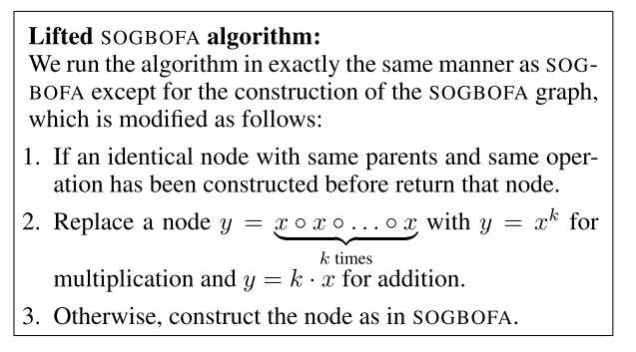
Lifted SOGBOFA
BP[x]
Compress Graph Size!

Slide 8
Conformant-Lifted SOFBOFA
Pitfalls: Random Rollout Policy is not informative enough!
Elevators Domain!!
Use a informed rollout policy
Trial: time not enough

Slide 9
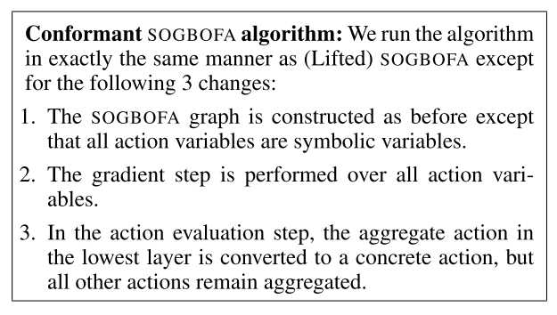
Conformant SOFBOFA

Slide 10
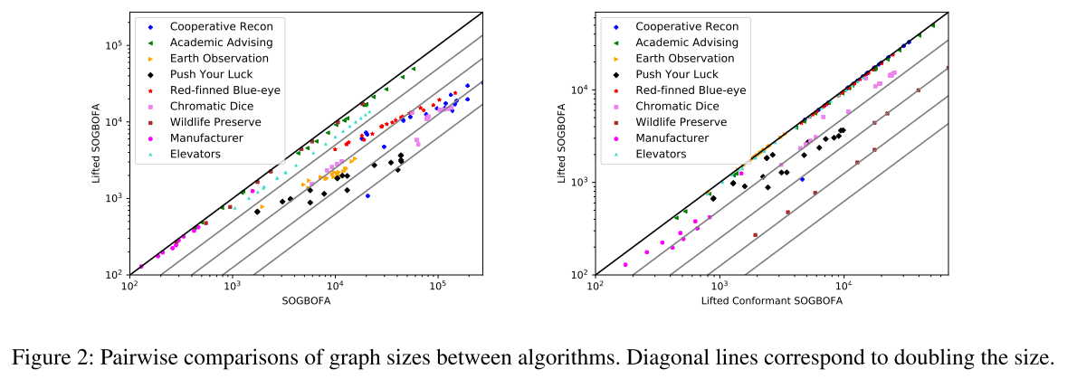
Elevator
Graph Size

Slide 11
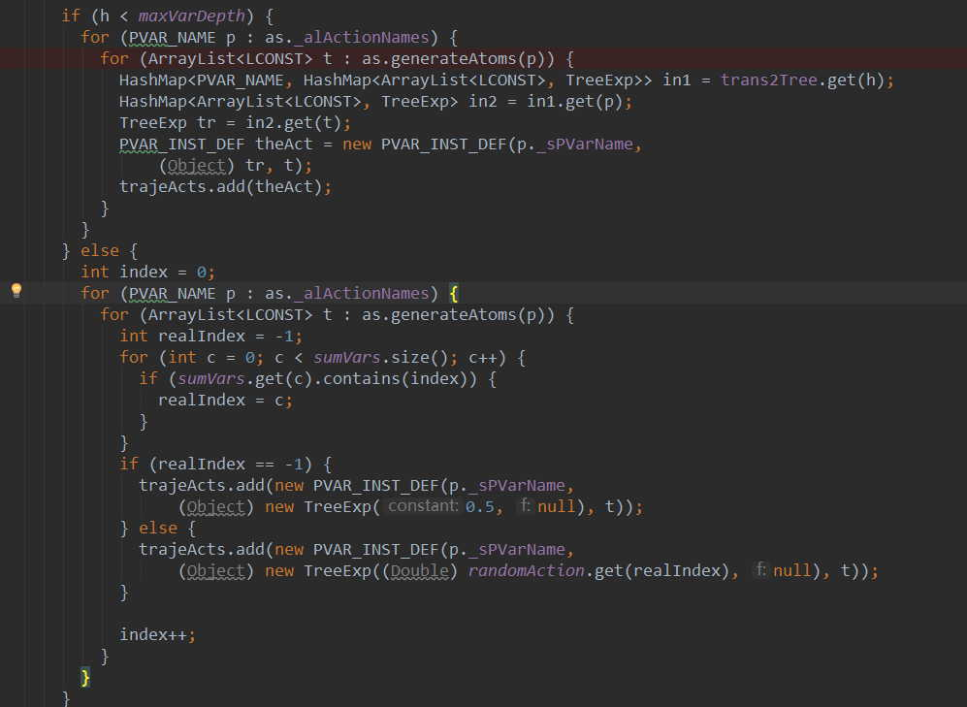
Code

Slide 12
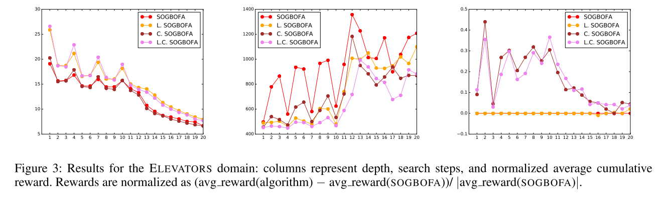
Elevator
Balance: size & search depth
Lifted
Conformant

Slide 13
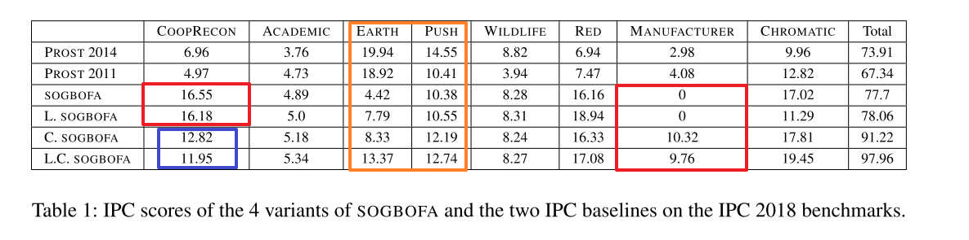
IPPC-2018 Benchmark

Slide 14
Main idea
while(has time)
{
RandomRestart 生成动作的概率
Projection 检查约束
while(has time && not conv. )
{
Cal Gradient 计算梯度
MakeUpdate 更新动作的概率
Projection 检查约束
}
Sample Concrete Action 根据概率分布抽样出具体动作，作为备选的动作。
}

Slide 15
Summary
Year | Algo | note
2015 | ARollout | Algebraic Rollout (concrete trial)
2016 | SOGBOFA | Symbolic Rollout (symbolic trial) Symbolic Gradient-Based Optimization for Factored Action MDP
2018 | L-SOGBOFA | Lifted (reduce graph size)
2019 | L-C-SOGBOFA | Conformant (improve random policy)

Slide 16
Improve Ideas
Build graph, Graph size
Complex rollout policy
Problems need deep search
Emergency Return

Slide 17
Thanks!

